Slide 1
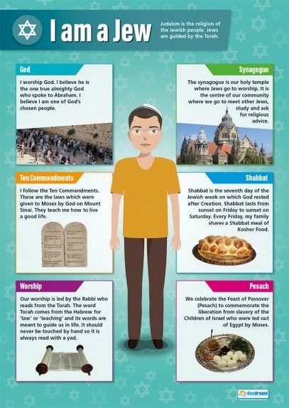
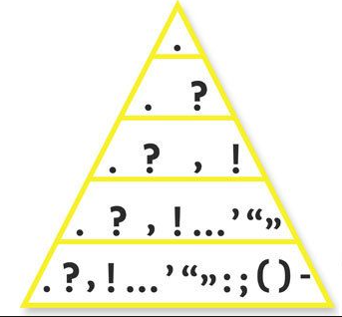
Writing Skills Checklist
Level up your punctuation
Write clearly, legibly and accurately
Use correct spelling
Punctuate your sentences accurately and consistently
Choose appropriate, ambitious and effective vocabulary
Match your writing to the purpose and audience
Write in clear paragraphs that develop logically and make sense (plan!)
Link your paragraphs using effective connectives
Vary your sentences for clarity and purpose
1
E
9
A

Slide 2
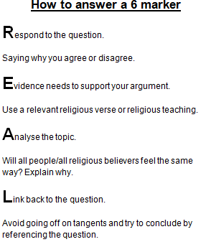


Reading Skills Checklist
Common mistakes
WHAT HOW WHY
Understand, deduce and infer information from texts
Interpret texts to explain what an author means or wants us to think
Identify and explain how structural features such as connectives and tense are used to direct the reader
Identify and explain writers’ language choices
Identify and explain how writers have used techniques such as: Repetition, rhetorical questions, alliteration, metaphor, simile
Comment on a writer’s purpose and viewpoint
Comment on the overall effect of the text on the reader
Could of
Alot
Allways
Then/than
Your/you’re
Weather/
Whether
Could have
A lot (2 words)
Always
Then=time
Than=compares
Your=belongs to
You’re=you are
Weather=windy
Whether=if

Slide 3
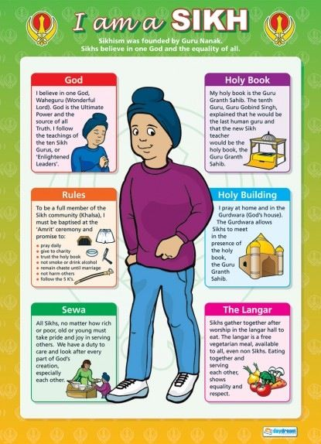
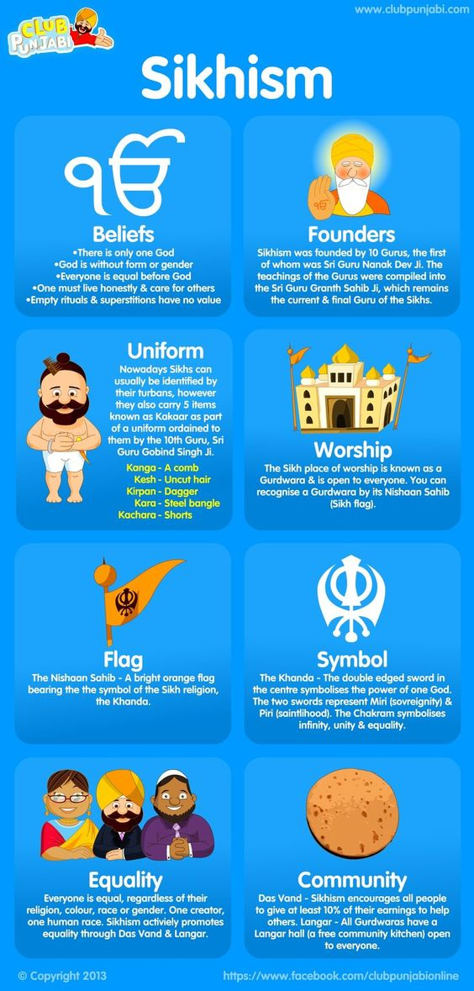
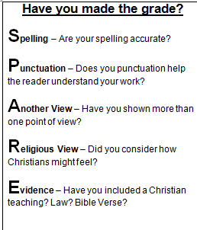
Paragraph Starters
Using PEEL
P
POINT: THE WRITER/POET/NARRATOR..
Explores, introduces, suggests, expresses, describes, contrasts, highlights, foreshadows..
E
Evidence: USE SUPPORTING QUOTES
This is particularly evident when, as shown in, demonstrated by, this is clear when, as seen…
Explain: PROVE YOUR POINT
Explores, introduces, suggests, expresses, describes, contrasts, highlights, foreshadows..
E
L
Link: LINK TO CONTEXT – EXPLAIN WHY
The writer does this to… explore, challenge, undermine, juxtapose, explain, make clear…

Slide 4
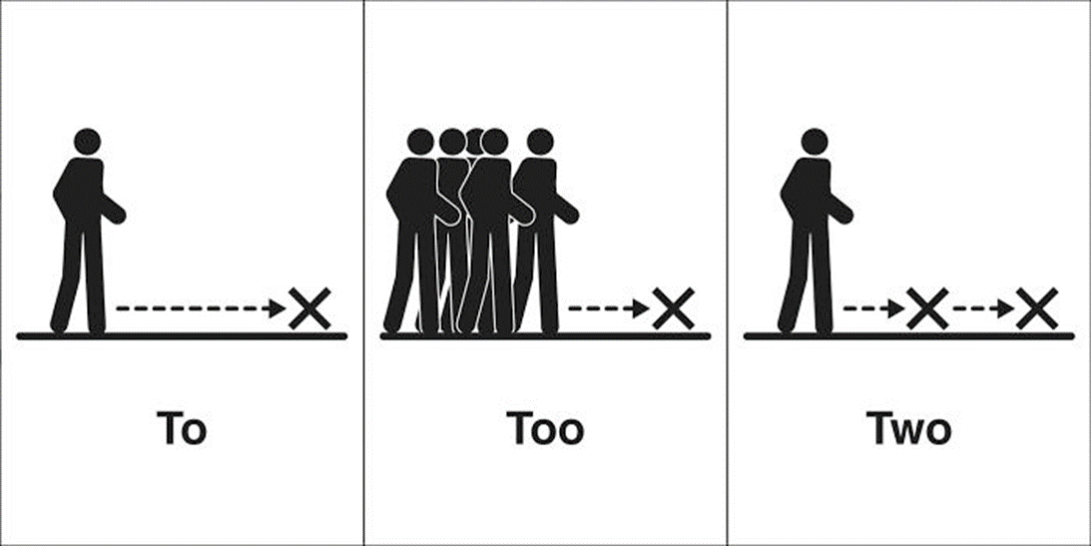
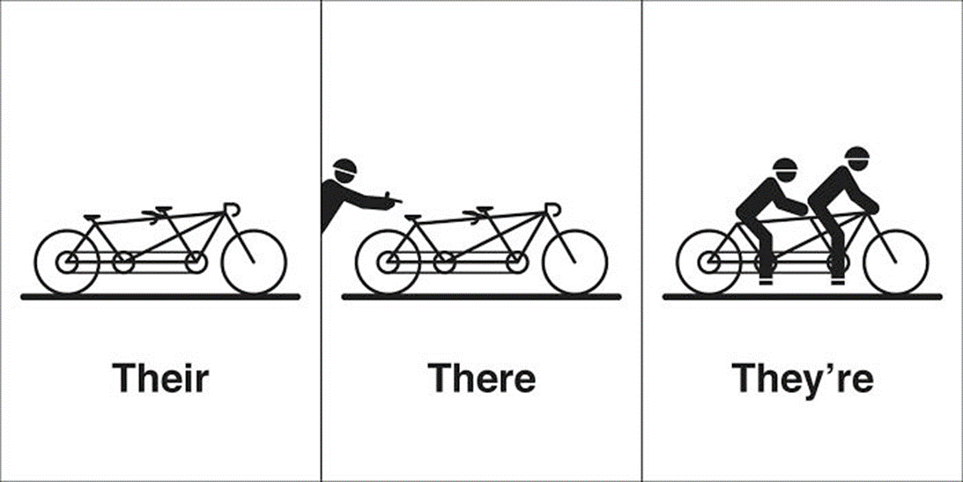
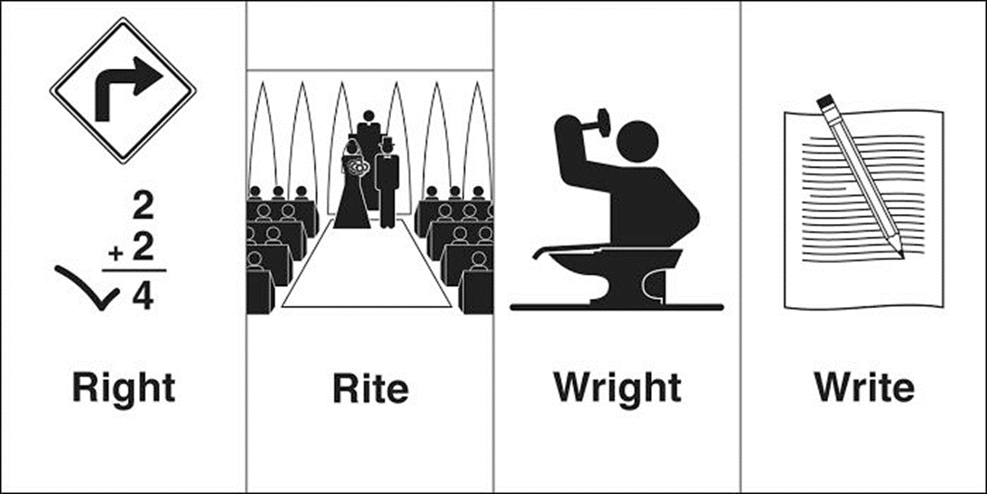
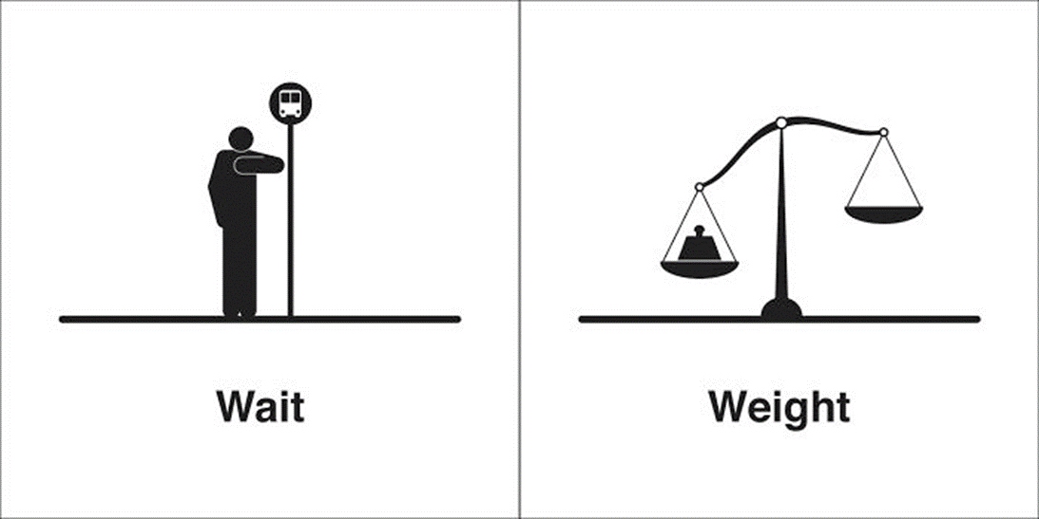
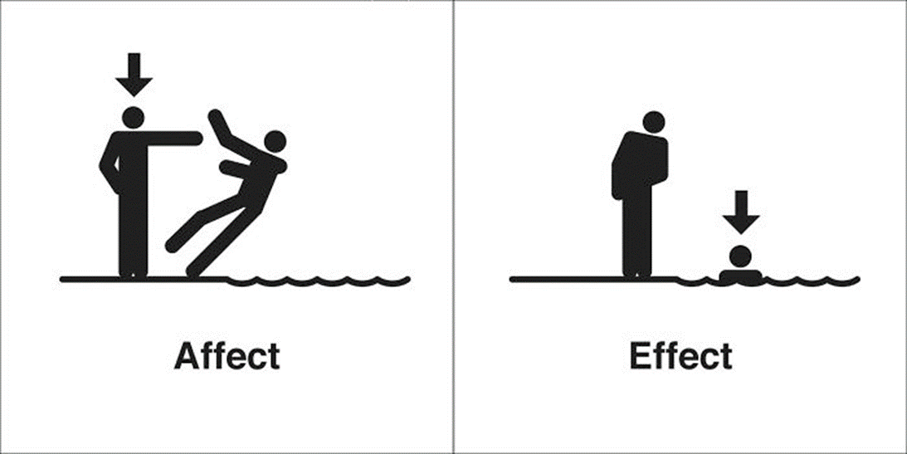
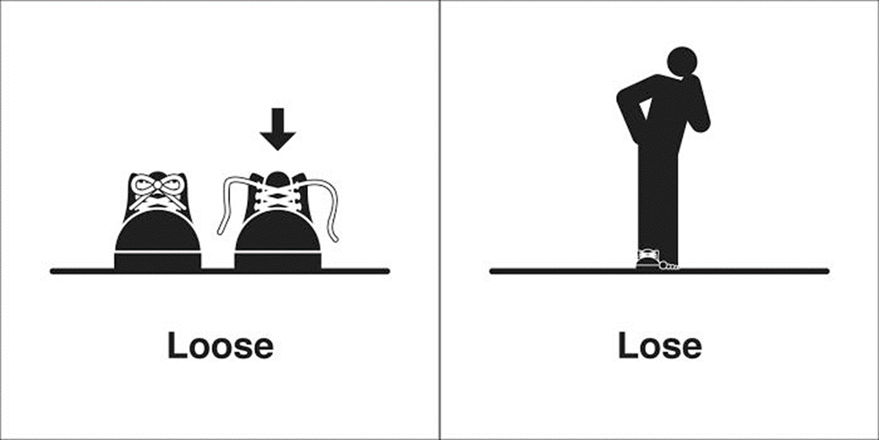
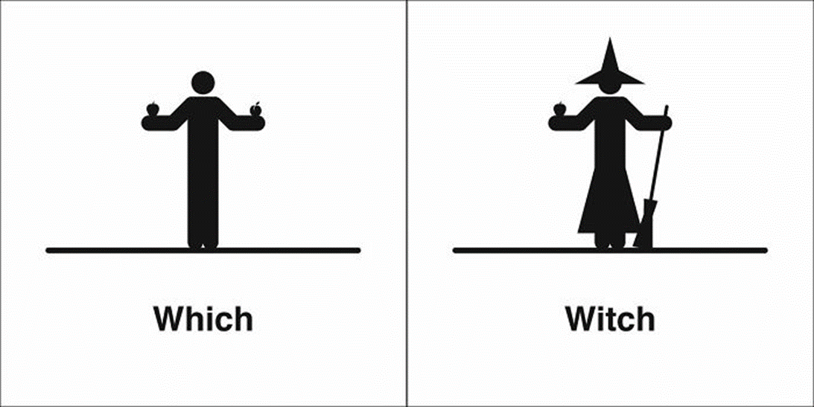

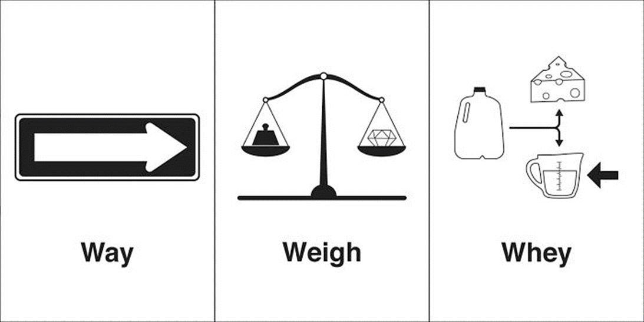
Know your homophones
Know your homophones
Know your homophones

Slide 5
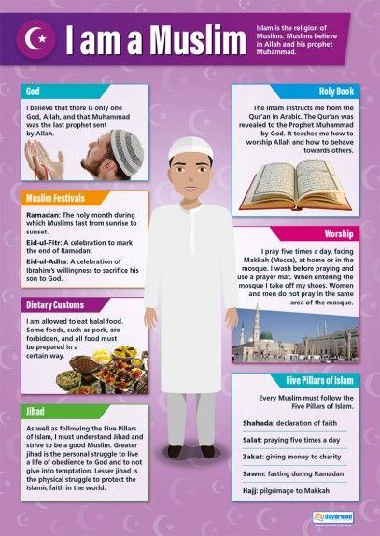


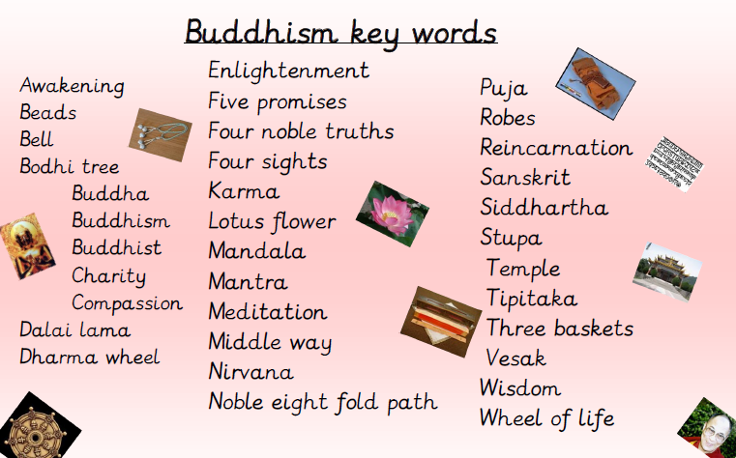
Islam
Connectives
Contrast:
however,
but,
in contrast,
whereas, alternatively
Add information:
also,
in addition, moreover, furthermore,
thus,
Emphasise:
particularly significantly
notably,
above all,
especially
Compare:
similarly
equally,
in the same way,
likewise

Slide 6
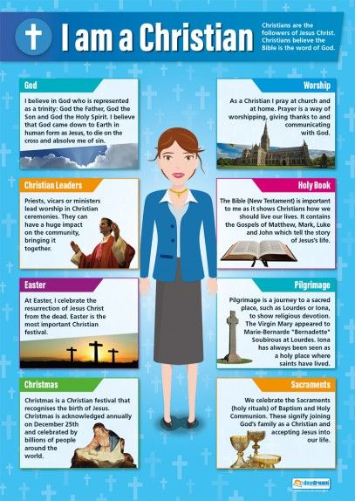
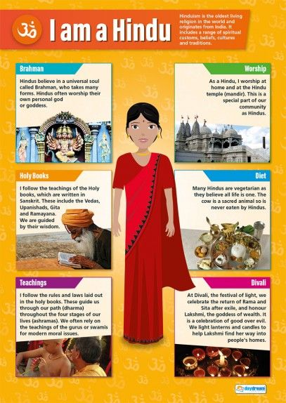
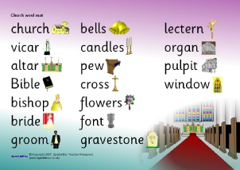
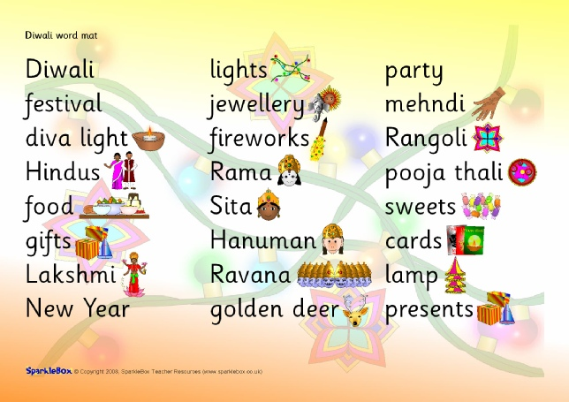




Church
Hinduism
TiP ToP Paragraphs
Start a new paragraph every time you change …
Time
Person
Topic
Place

Slide 7
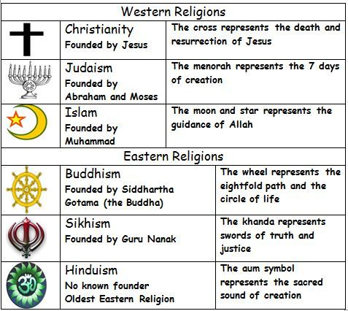
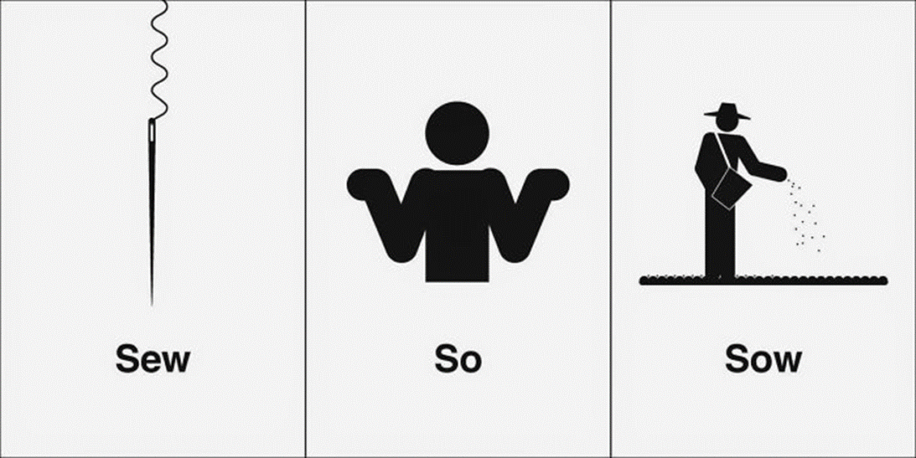
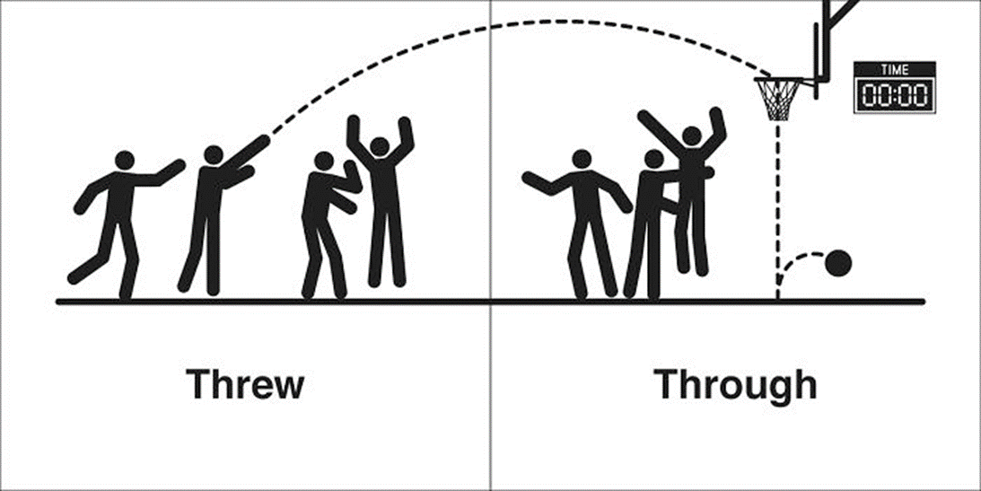
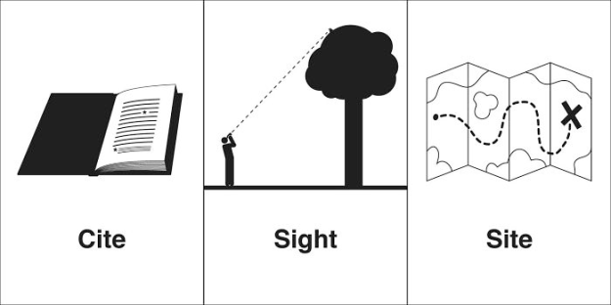
 | Punctuation rules
. | Marks the end of a sentence that is not a question or exclamation.
, | Separates clauses and items in a list. Used before speech and some conjunctions.
! | Use at the end of a sentence to show surprise or a strong emotion.
? | Use to indicate a question or a feeling of disbelief.
; | Use to add a linked idea to your sentence and to break up lists of long clauses/ideas.
: | Use before a list, extra information, or an explanation.
‘ | Used to replace missing letters or show possession.
… | Used at the end of a sentence to create suspense by showing an unfinished idea.
( ) | Used to add an extra piece of information to a sentence.
“ “ | Used to show direct speech: what someone has actually said, not what they’re reported as having said.
Know your homophones

