Slide 1

Philosophy
& Ethics
Philosophy
& Ethics
Philosophy
& Ethics
Philosophy
& Ethics

Slide 2


Add to the graffiti with other Christian descriptive words for God
Add to the graffiti with other Christian descriptive words for God
Add to the graffiti with other Christian descriptive words for God
Add to the graffiti with other Christian descriptive words for God

Slide 3
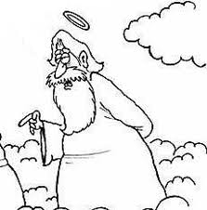
Can you doodle an image of God? Is it easy? (remember to be respectful!)
Can you doodle an image of God? Is it easy? (remember to be respectful!)
Can you doodle an image of God? Is it easy? (remember to be respectful!)
Can you doodle an image of God? Is it easy? (remember to be respectful!)

Slide 4
Doodle the first 6 days of creation...if you are unsure look up Genesis in the Bible
Doodle the first 6 days of creation...if you are unsure look up Genesis in the Bible
Doodle the first 6 days of creation...if you are unsure look up Genesis in the Bible
Doodle the first 6 days of creation...if you are unsure look up Genesis in the Bible

Slide 5

Above doodle how a Christian should treat the world. Need help? In the bible look up Psalm 96:10-13, Genesis 1:26. and Isaiah 24:4-6.
Above doodle how a Christian should treat the world. Need help? In the bible look up Psalm 96:10-13, Genesis 1:26. and Isaiah 24:4-6.
Above doodle how a Christian should treat the world. Need help? In the bible look up Psalm 96:10-13, Genesis 1:26. and Isaiah 24:4-6.
Above doodle how a Christian should treat the world. Need help? In the bible look up Psalm 96:10-13, Genesis 1:26. and Isaiah 24:4-6.

Slide 6
Your body is a temple of the Holy Spirit. 1 Corinthians 6:19 Can you doodle an image to show this...?
Thunk...What might this mean for Christians?
Your body is a temple of the Holy Spirit. 1 Corinthians 6:19 Can you doodle an image to show this...?
Thunk...What might this mean for Christians?
Your body is a temple of the Holy Spirit. 1 Corinthians 6:19 Can you doodle an image to show this...?
Thunk...What might this mean for Christians?
Your body is a temple of the Holy Spirit. 1 Corinthians 6:19 Can you doodle an image to show this...?
Thunk...What might this mean for Christians?

Slide 7
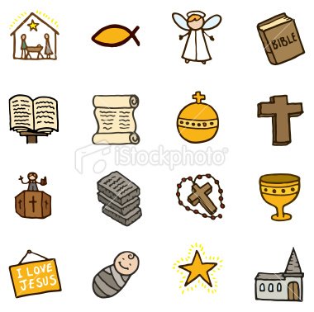
Label the religious symbols
Label the religious symbols
Label the religious symbols
Label the religious symbols

Slide 8
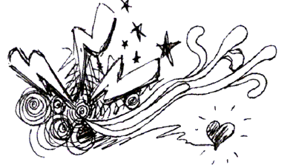
Extend the doodle below to show God’s powers
Extend the doodle below to show God’s powers
Extend the doodle below to show God’s powers
Extend the doodle below to show God’s powers

Slide 9
Omni
Omni
On this page doodle all the different omnis we use in RE
On this page doodle all the different omnis we use in RE
Omni
Omni
On this page doodle all the different omnis we use in RE
On this page doodle all the different omnis we use in RE

Slide 10
Agape
Agape
Agape means charitable love, like the kind Jesus preached about. Can you doodle what Christians would do in their life who think they should follow Jesus and show agape
Agape means charitable love, like the kind Jesus preached about. Can you doodle what Christians would do in their life who think they should follow Jesus and show agape
Agape
Agape
Agape means charitable love, like the kind Jesus preached about. Can you doodle what Christians would do in their life who think they should follow Jesus and show agape
Agape means charitable love, like the kind Jesus preached about. Can you doodle what Christians would do in their life who think they should follow Jesus and show agape

Slide 11
You shall not murder.Exodus 20:13
Can you doodle a time some Christians might disagree with this!?
You shall not murder.Exodus 20:13
Can you doodle a time some Christians might disagree with this!?
You shall not murder.Exodus 20:13
Can you doodle a time some Christians might disagree with this!?
You shall not murder.Exodus 20:13
Can you doodle a time some Christians might disagree with this!?

Slide 12
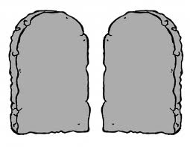
The 10 commandments help Christian know how to live a good life – can you doodle images to represent them above?
The 10 commandments help Christian know how to live a good life – can you doodle images to represent them above?
The 10 commandments help Christian know how to live a good life – can you doodle images to represent them above?
The 10 commandments help Christian know how to live a good life – can you doodle images to represent them above?

Slide 13
THEIST
THEIST
AGNOSTIC
AGNOSTIC
ATHEIST
ATHEIST
Doodle something to represent the keywords!
Doodle something to represent the keywords!
THEIST
THEIST
AGNOSTIC
AGNOSTIC
ATHEIST
ATHEIST
Doodle something to represent the keywords!
Doodle something to represent the keywords!

Slide 14
Christian believe in one God (monotheism) made up of three parts called the trinity. This shows the different characteristics of God....
Christian believe in one God (monotheism) made up of three parts called the trinity. This shows the different characteristics of God....
Father
Father
GOD
GOD
Holy spirit
Son
Holy spirit
Son
Doodle images to represent the different parts!
Doodle images to represent the different parts!
Christian believe in one God (monotheism) made up of three parts called the trinity. This shows the different characteristics of God....
Christian believe in one God (monotheism) made up of three parts called the trinity. This shows the different characteristics of God....
Father
Father
GOD
GOD
Holy spirit
Son
Holy spirit
Son
Doodle images to represent the different parts!
Doodle images to represent the different parts!

Slide 15
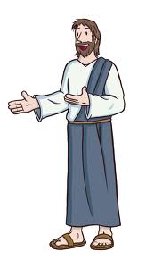
Jesus was sent, by God, to show people how to live their lives and follow God...
Jesus was sent, by God, to show people how to live their lives and follow God...
Can you doodle things Jesus did to show Christians how to live? Use a Bible and the New Testament if you need to
Can you doodle things Jesus did to show Christians how to live? Use a Bible and the New Testament if you need to
Jesus was sent, by God, to show people how to live their lives and follow God...
Jesus was sent, by God, to show people how to live their lives and follow God...
Can you doodle things Jesus did to show Christians how to live? Use a Bible and the New Testament if you need to
Can you doodle things Jesus did to show Christians how to live? Use a Bible and the New Testament if you need to

Slide 16
Religion has a great deal to say about 'good' and 'evil'. Religious leaders and sacred texts all encourage believers to live 'good' lives.
Religion has a great deal to say about 'good' and 'evil'. Religious leaders and sacred texts all encourage believers to live 'good' lives.
Doodle the two types of evil...moral evil and natural evil!
Doodle the two types of evil...moral evil and natural evil!
Religion has a great deal to say about 'good' and 'evil'. Religious leaders and sacred texts all encourage believers to live 'good' lives.
Religion has a great deal to say about 'good' and 'evil'. Religious leaders and sacred texts all encourage believers to live 'good' lives.
Doodle the two types of evil...moral evil and natural evil!
Doodle the two types of evil...moral evil and natural evil!

Slide 17
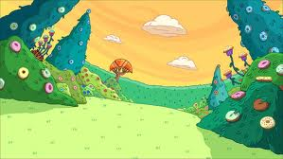
Some Christians look to Genesis, the first book of the Bible, to explain evil...
Some Christians look to Genesis, the first book of the Bible, to explain evil...
Can you add to the picture with doodles and words to show who could be blamed for causing evil in the world. Use Genesis 2 from the Bible to aid you.
Can you add to the picture with doodles and words to show who could be blamed for causing evil in the world. Use Genesis 2 from the Bible to aid you.
Some Christians look to Genesis, the first book of the Bible, to explain evil...
Some Christians look to Genesis, the first book of the Bible, to explain evil...
Can you add to the picture with doodles and words to show who could be blamed for causing evil in the world. Use Genesis 2 from the Bible to aid you.
Can you add to the picture with doodles and words to show who could be blamed for causing evil in the world. Use Genesis 2 from the Bible to aid you.

Slide 18
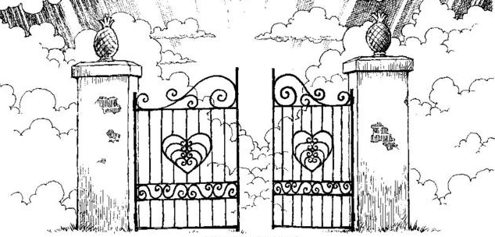
Jesus rose from the dead three days after he had been crucified. This is called the Resurrection. From that time onwards people who follow his teachings will go to heaven.
Jesus rose from the dead three days after he had been crucified. This is called the Resurrection. From that time onwards people who follow his teachings will go to heaven.
Can you doodle your version of heave. You might add doodles of what a Christian would have to do to get there...
Can you doodle your version of heave. You might add doodles of what a Christian would have to do to get there...
Jesus rose from the dead three days after he had been crucified. This is called the Resurrection. From that time onwards people who follow his teachings will go to heaven.
Jesus rose from the dead three days after he had been crucified. This is called the Resurrection. From that time onwards people who follow his teachings will go to heaven.
Can you doodle your version of heave. You might add doodles of what a Christian would have to do to get there...
Can you doodle your version of heave. You might add doodles of what a Christian would have to do to get there...

Slide 19
Doodle the meaning of the bible passage "Love your enemies, do good to those who hate you." (Luke 7)
Doodle the meaning of the bible passage "Love your enemies, do good to those who hate you." (Luke 7)
Doodle the meaning of the bible passage "Love your enemies, do good to those who hate you." (Luke 7)
Doodle the meaning of the bible passage "Love your enemies, do good to those who hate you." (Luke 7)

Slide 20
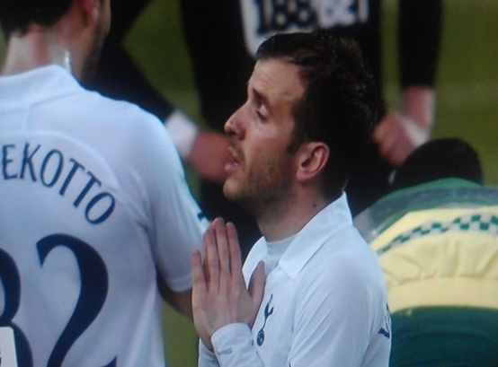
Doodle the reason Christians...
Doodle the reason Christians...
...pray, what do they thing it will do?
...pray, what do they thing it will do?
Doodle the reason Christians...
Doodle the reason Christians...
...pray, what do they thing it will do?
...pray, what do they thing it will do?

Slide 21
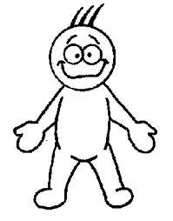
Doodle why humans...
Doodle why humans...
...might be important to God
...might be important to God
Doodle why humans...
Doodle why humans...
...might be important to God
...might be important to God

Slide 22
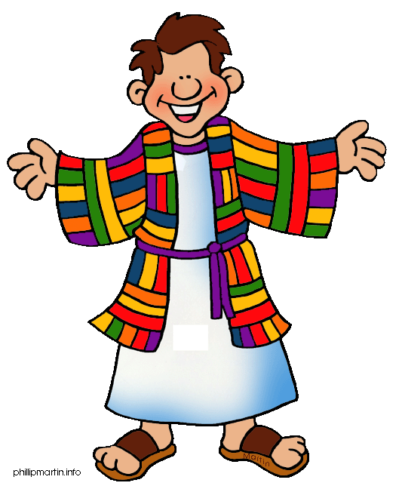
Lots of bad things happened to Joseph in the Bible (read Genesis 37-50 if you don’t know it)
Lots of bad things happened to Joseph in the Bible (read Genesis 37-50 if you don’t know it)
Doodle all the bad things that happened to Joseph. What good came from this? What does it show about suffering?!
Doodle all the bad things that happened to Joseph. What good came from this? What does it show about suffering?!
Lots of bad things happened to Joseph in the Bible (read Genesis 37-50 if you don’t know it)
Lots of bad things happened to Joseph in the Bible (read Genesis 37-50 if you don’t know it)
Doodle all the bad things that happened to Joseph. What good came from this? What does it show about suffering?!
Doodle all the bad things that happened to Joseph. What good came from this? What does it show about suffering?!

Slide 23
Doodle the things Christians might blame for suffering. Think about God, people and beings!
Doodle the things Christians might blame for suffering. Think about God, people and beings!
Circle who, or what, you think is mostly to blame!
Circle who, or what, you think is mostly to blame!
Doodle the things Christians might blame for suffering. Think about God, people and beings!
Doodle the things Christians might blame for suffering. Think about God, people and beings!
Circle who, or what, you think is mostly to blame!
Circle who, or what, you think is mostly to blame!

Slide 24
Doodle something to show how evolution, Charles Darwin’s theory works...
Doodle something to show how evolution, Charles Darwin’s theory works...
Can you fit God in anywhere?!
Can you fit God in anywhere?!
Doodle something to show how evolution, Charles Darwin’s theory works...
Doodle something to show how evolution, Charles Darwin’s theory works...
Can you fit God in anywhere?!
Can you fit God in anywhere?!

Slide 25
Christians feel that life is sacred...
Christians feel that life is sacred...
Doodle things a Christians would not do if they think this
Doodle things a Christians would not do if they think this
Christians feel that life is sacred...
Christians feel that life is sacred...
Doodle things a Christians would not do if they think this
Doodle things a Christians would not do if they think this

Slide 26
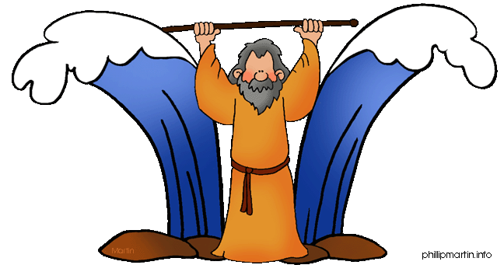
Moses did lots of amazing things in Exodus in the Bible...
Moses did lots of amazing things in Exodus in the Bible...
Doodle all the amazing things that God allowed him to do (the miracles). Think about what this tells people who read the Bible about God!
Doodle all the amazing things that God allowed him to do (the miracles). Think about what this tells people who read the Bible about God!
Moses did lots of amazing things in Exodus in the Bible...
Moses did lots of amazing things in Exodus in the Bible...
Doodle all the amazing things that God allowed him to do (the miracles). Think about what this tells people who read the Bible about God!
Doodle all the amazing things that God allowed him to do (the miracles). Think about what this tells people who read the Bible about God!

Slide 27
Doodle any miracles that you know about from the Bible...
Doodle any miracles that you know about from the Bible...
What do they show Christians about God and how to live their life?
What do they show Christians about God and how to live their life?
Doodle any miracles that you know about from the Bible...
Doodle any miracles that you know about from the Bible...
What do they show Christians about God and how to live their life?
What do they show Christians about God and how to live their life?

Slide 28
Doodle something Christians might pray for...
Doodle something Christians might pray for...
Why do Christians pray to God? What do they think will happen?
Why do Christians pray to God? What do they think will happen?
Doodle something Christians might pray for...
Doodle something Christians might pray for...
Why do Christians pray to God? What do they think will happen?
Why do Christians pray to God? What do they think will happen?

Slide 29
Doodle when life begins in your opinion and add a reason why. (be respectful and sensible)..
Doodle when life begins in your opinion and add a reason why. (be respectful and sensible)..
Doodle when life begins in your opinion and add a reason why. (be respectful and sensible)..
Doodle when life begins in your opinion and add a reason why. (be respectful and sensible)..

Slide 30

Add to the image to complete the scene. Label the important parts and what they show Christians
Add to the image to complete the scene. Label the important parts and what they show Christians
Add to the image to complete the scene. Label the important parts and what they show Christians
Add to the image to complete the scene. Label the important parts and what they show Christians

Slide 31
Doodle below how an atheist might think the world began...
Doodle below how an atheist might think the world began...
Doodle below how an atheist might think the world began...
Doodle below how an atheist might think the world began...

Slide 32
Below is a section of the Bible called ‘The Beatitudes’ from Matthew. Doodle around it who the bible says is bless.
Below is a section of the Bible called ‘The Beatitudes’ from Matthew. Doodle around it who the bible says is bless.
Blessed are the poor in spirit: for theirs is the kingdom of heaven.
Blessed are they that mourn: for they shall be comforted.
Blessed are the meek: for they shall inherit the earth.
Blessed are they which do hunger and thirst after righteousness: for they shall be filled.
Blessed are the merciful: for they shall obtain mercy.
Blessed are the pure in heart: for they shall see God.
Blessed are the peacemakers: for they shall be called the children of God.
Blessed are they which are persecuted for righteousness' sake: for theirs is the kingdom of heaven.
Blessed are the poor in spirit: for theirs is the kingdom of heaven.
Blessed are they that mourn: for they shall be comforted.
Blessed are the meek: for they shall inherit the earth.
Blessed are they which do hunger and thirst after righteousness: for they shall be filled.
Blessed are the merciful: for they shall obtain mercy.
Blessed are the pure in heart: for they shall see God.
Blessed are the peacemakers: for they shall be called the children of God.
Blessed are they which are persecuted for righteousness' sake: for theirs is the kingdom of heaven.
Below is a section of the Bible called ‘The Beatitudes’ from Matthew. Doodle around it who the bible says is bless.
Below is a section of the Bible called ‘The Beatitudes’ from Matthew. Doodle around it who the bible says is bless.
Blessed are the poor in spirit: for theirs is the kingdom of heaven.
Blessed are they that mourn: for they shall be comforted.
Blessed are the meek: for they shall inherit the earth.
Blessed are they which do hunger and thirst after righteousness: for they shall be filled.
Blessed are the merciful: for they shall obtain mercy.
Blessed are the pure in heart: for they shall see God.
Blessed are the peacemakers: for they shall be called the children of God.
Blessed are they which are persecuted for righteousness' sake: for theirs is the kingdom of heaven.
Blessed are the poor in spirit: for theirs is the kingdom of heaven.
Blessed are they that mourn: for they shall be comforted.
Blessed are the meek: for they shall inherit the earth.
Blessed are they which do hunger and thirst after righteousness: for they shall be filled.
Blessed are the merciful: for they shall obtain mercy.
Blessed are the pure in heart: for they shall see God.
Blessed are the peacemakers: for they shall be called the children of God.
Blessed are they which are persecuted for righteousness' sake: for theirs is the kingdom of heaven.

Slide 33
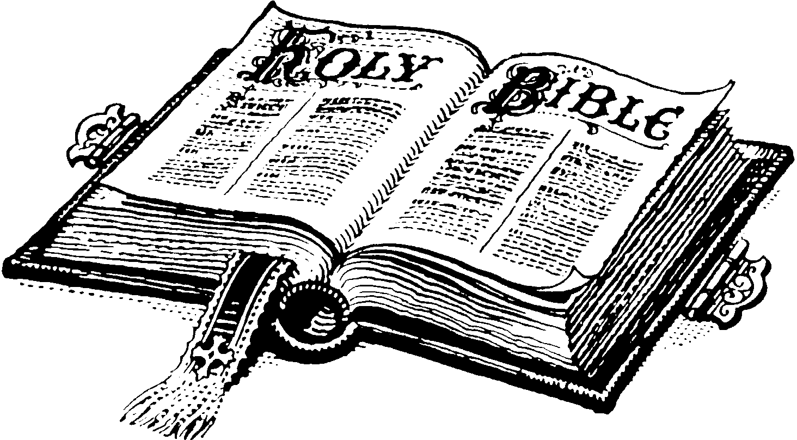
Doodle around the Bible any image you can to represent a story from it. Do you think the bible should be read literally or metaphorically?
Doodle around the Bible any image you can to represent a story from it. Do you think the bible should be read literally or metaphorically?
Doodle around the Bible any image you can to represent a story from it. Do you think the bible should be read literally or metaphorically?
Doodle around the Bible any image you can to represent a story from it. Do you think the bible should be read literally or metaphorically?

Slide 34
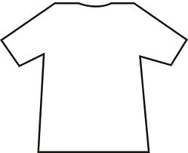
Doodle a T-shirt Charles Darwin might have worn about his views!
Doodle a T-shirt Charles Darwin might have worn about his views!
Doodle a T-shirt Charles Darwin might have worn about his views!
Doodle a T-shirt Charles Darwin might have worn about his views!

Slide 35
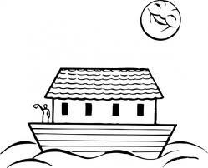
Add to the image to complete the scene. What does this story tell Christians about suffering (think about the people not on the boat!).
Add to the image to complete the scene. What does this story tell Christians about suffering (think about the people not on the boat!).
Add to the image to complete the scene. What does this story tell Christians about suffering (think about the people not on the boat!).
Add to the image to complete the scene. What does this story tell Christians about suffering (think about the people not on the boat!).

Slide 36
Add to the graffiti with other Christian descriptive words for God
Add to the graffiti with other Christian descriptive words for God
Add to the graffiti with other Christian descriptive words for God
Add to the graffiti with other Christian descriptive words for God

Slide 37
Extend the doodle below to show God’s powers
Extend the doodle below to show God’s powers
Extend the doodle below to show God’s powers
Extend the doodle below to show God’s powers

Slide 38
Omni
Omni
On this page doodle all the different omnis we use in RE
On this page doodle all the different omnis we use in RE
Omni
Omni
On this page doodle all the different omnis we use in RE
On this page doodle all the different omnis we use in RE

Slide 39
Agape
Agape
Agape means charitable love, like the kind Jesus preached about. Can you doodle what Christians would do in their life who think they should follow Jesus and show agape
Agape means charitable love, like the kind Jesus preached about. Can you doodle what Christians would do in their life who think they should follow Jesus and show agape
Agape
Agape
Agape means charitable love, like the kind Jesus preached about. Can you doodle what Christians would do in their life who think they should follow Jesus and show agape
Agape means charitable love, like the kind Jesus preached about. Can you doodle what Christians would do in their life who think they should follow Jesus and show agape

Slide 40
THEIST
THEIST
AGNOSTIC
AGNOSTIC
ATHEIST
ATHEIST
Doodle something to represent the keywords!
Doodle something to represent the keywords!
THEIST
THEIST
AGNOSTIC
AGNOSTIC
ATHEIST
ATHEIST
Doodle something to represent the keywords!
Doodle something to represent the keywords!

