Slide 1
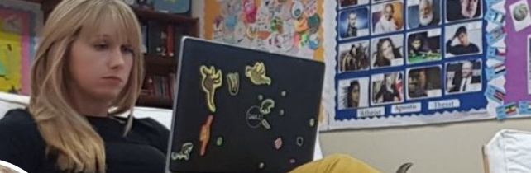



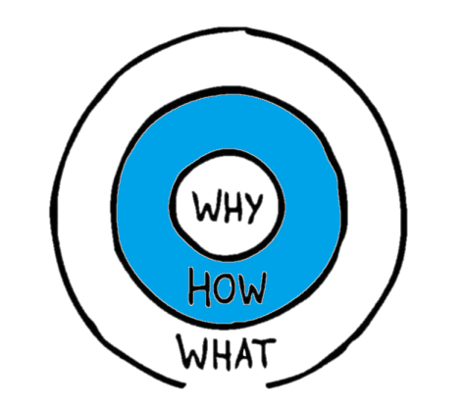
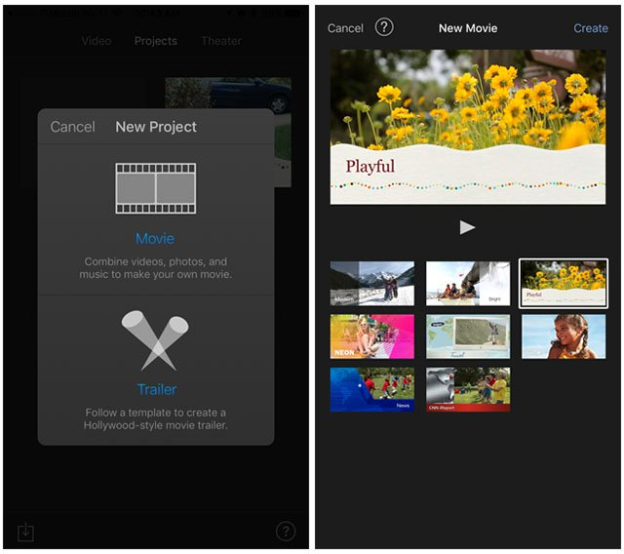


iMovies App
@Mrs_Educate iPad Guide
Apple iMovies is another app that is included on the iPad for free. It is another good movie making app that has inbuilt effects.
iMovie is great for making all kinds of movies and trailers. Hollywood-style trailers and stunning 4K-resolution movies. You can even start editing on iPhone or iPad, then finish on your Mac.
Using the iMovies App already built into the iPad pupils and staff can make videos at the click of one button that can be shared or downloaded.
This app is great for-
Explaining a topic
Giving feedback
Examine photos
Give instructions
Overviews
Trailers
Roleplays

Slide 2

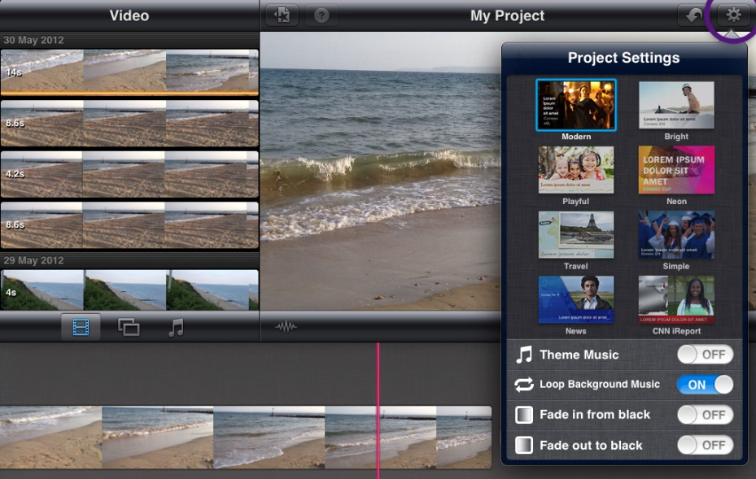
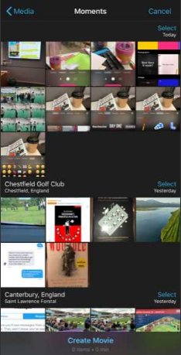


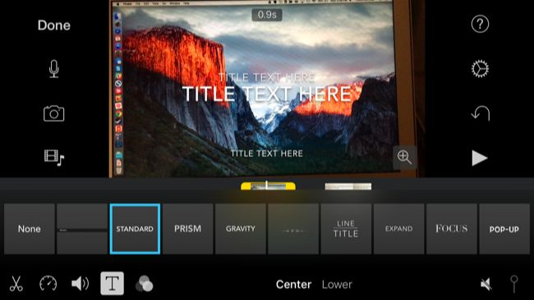

Firstly you need to pick either a trailer or a movie. A trailer will give you sections that must be filled in and some themes. It’s good to use but can be time consuming to sort it all. Movies allows you to add in what you’d like and when.
Te get going in movie click down here!
Don’t forget that cogs buttons are for changing something and plus buttons add something
Want to change the theme? Look for the cog button here!
If you click on the image or photo then you can add titles and change the image here. TIP: Change the section that says centre of lower for different type of titles.
Find out more using one of these links –
https://www.youtube.com/watch?v=gdEUZY4wStI
https://support.apple.com/en-gb/imovie
https://www.igeeksblog.com/how-to-create-movie-with-imovie-app-on-ipad/

