Slide 1
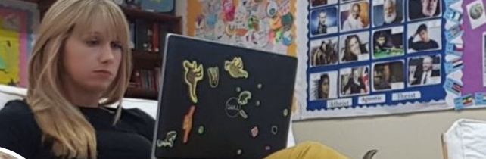





Learn More on iPad
@Mrs_Educate iPad Guide
https://www.apple.com/uk/education/everyone-can-create/
Everyone Can
Create ibook
First go to resource is the Everyone Can Create ibooks made by Apple. These have four books, aimed for audio, video, music and photo, to aid pupils learning on each format. There is also a teacher book. Very interactive with videos and mini projects to work through. Would make a fab workbook for staff too!
TRAMS
Training
http://www.trams.co.uk/ipad-training
TRAMs iPad training is a great way to find out about new apps that have been created. Loads of newbie Apple iPad learners in a great location, such as Science Museum. Free for training, just need to pay to get there. Very practical and easy to access CPD.
https://www.apple.com/uk/education/apple-teacher/
Apple Teacher
Badges
Apple badges are a must for anyone and any school learning to use iPads. There are self taught and cover all the main items on an iPad, such as iMovie and Garage Band. Each badge has information to leaner and then a test that can be taken as many times as needed. Collect them all and you become an Apple Teacher and can add the logo to your email!
Twitter
#AppleEDUChat
https://twitter.com/search?q=%23AppleEDUchat&src=tyah&lang=en-gb
Every Tuesday, on Twitter, if you search for #AppleEDUChat then you can see loads of people discussing certain apps of ideas about using iPads in school. Plus you can find out the main game players in the Apple iPad Education world, opening your door to a free source of information. Basically free CPD!

