Slide 1





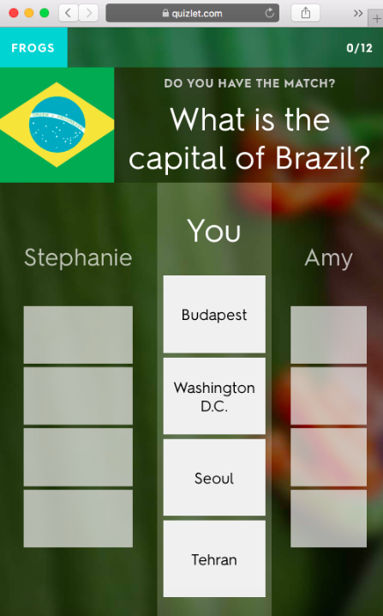


Quizlet Live
@Mrs_Educate iPad Guide
Quizlet and Quizlet live are online based as well as app based and are fab for revision and testing progress of a class.
Quizlet is very good at practising key terms for a topic and Quizlet lives allows you to test a class on these with the focus on collaboration rather than individuals. Groups are randomly picked by the app.
Using the web based Quizlet site you can create different study sets and challenge your pupils to use them to practise or improve knowledge.
This is great for –
GCSE revision
End of unit tests
Setting for homework
Working as a team

Slide 2
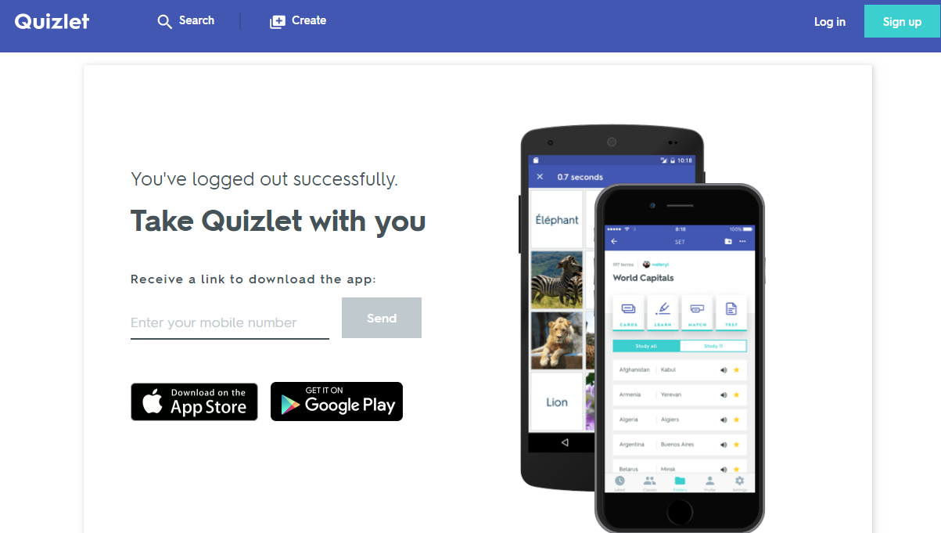

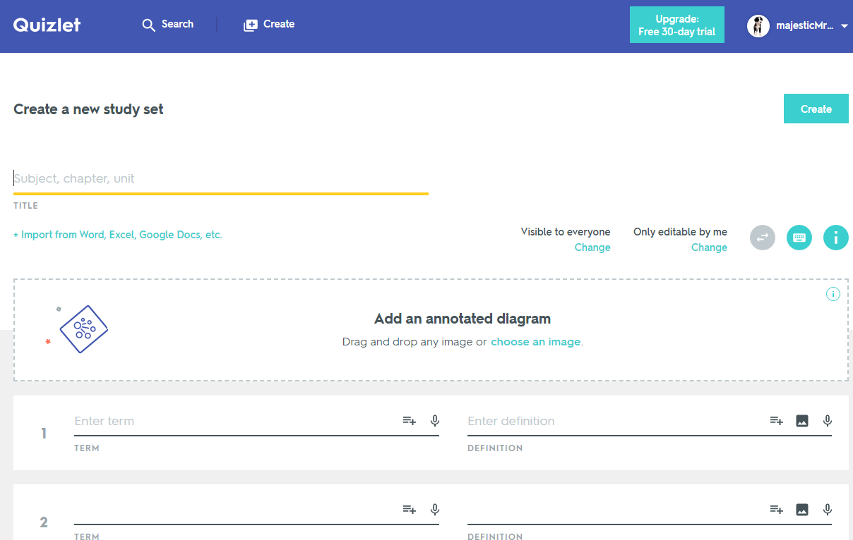
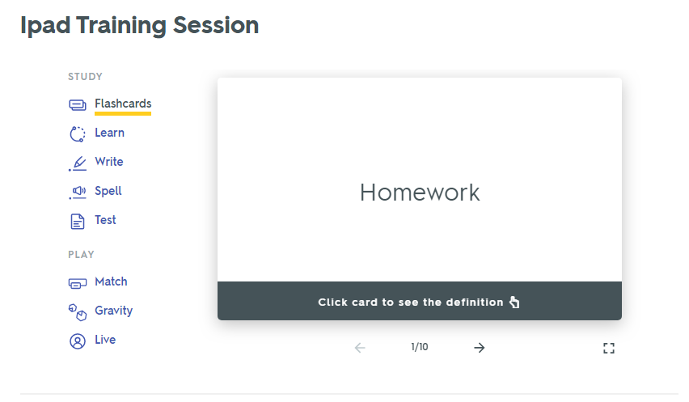
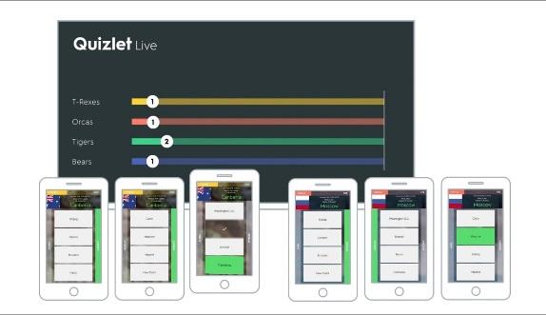
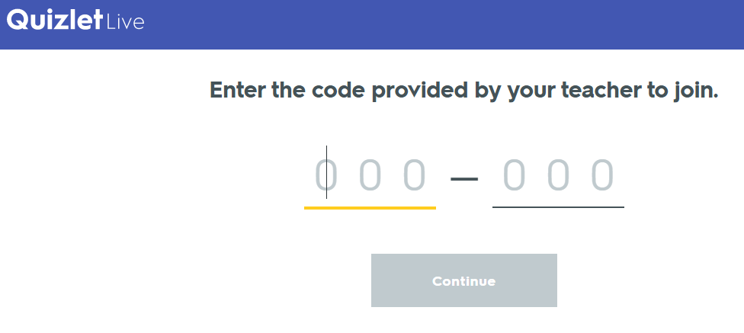

Firstly you need to go to www.quizlet.com to sign up for quizlet or use the app.
Then you need to create study sets. For this you can add key words and their definitions.
Once created you can share with pupils like this to revise and play different games.
You can also search through study sets others have created to save you time!
Once created you have lots of options but to play Quizlet live you need to click on the “Live” button and go through the options until it gives you a 6 digit code.
Pupils must not got to quizlet.com but quizletlive.com
There they enter the code and join the game! Progress is shown on your screen
The game also gives you a report at the end with how well everyone did and common misconceptions to talk through
Find out more using one of these links –
https://www.youtube.com/watch?v=MI3kZ69W4cY
https://quizlet.com/en-gb/help/2444125/how-to-use-quizlet-live
Once here you can click the create button at the top to make key word study sets. TIP instead of key terms you can write in questions with the answers and use this as a quiz.

